Slide 1
UHV-I Session 8 Fulfilment in Relationship – Trust
Resolving anger, irritation, fear…

Slide 2
Interaction Before Main Session
Hear from participants about their exploration from previous day(s)
Q&A
Place some expected conclusions, find out if they also came to these/similar conclusions

Slide 3
Home Assignment
7.1. Are you able to see that a feeling of responsibility toward the body is required for your health to be ensured?
Share 3 instances from your life where your body became unwell due to lack of attention to the feeling of responsibility towards your body
7.2. Reflect on the program for health. Are you able to see the significance of the intake and daily routine?
Share 2 instances from your life where you could have avoided getting sick by taking the right kind of food
Share 2 instances from your life where you became unwell because your routine was upset
7.3. Is the topic of staying healthy necessary to be included in your education, in campus life?
Suggest in what form it can be included in education by teachers, management… (counselling, courses, etc.)
Suggest ways and means it can be implemented by you, other students, wardens… in campus life (in the student clubs, hostel, mess, canteen, health centre, etc.)

Slide 4
UHV-I Session 8 Fulfilment in Relationship – Trust
Resolving anger, irritation, fear…

Slide 5
Introduction
In previous sessions we had explored:
For human being, physical facility is necessary but relationship is also necessary
To live with fulfillment in relationship, right understanding of relationship is also necessary
Check again if
A. the unhappiness in our families, amongst friends is more due to lack of physical facility or
B. more due to lack of fulfillment in relationship
The major issue in family and friends is that of relationship;
In order to live in relationship, it is necessary to understand relationship
Without understanding relationship, it is difficult to live with fulfilment in relationship
The most fundamental thing in understanding relationship is to understand the feelings (values) in relationship
We will start our exploration on harmony in the family in this session

Slide 6
Harmony in the Family
Relationship is – between one self (I₁) and another self (I₂)*
There are feelings in relationship – in one self (I₁) for the other self (I₂)
These feelings can be recognized – they are definite (9 Feelings)
Their fulfilment, evaluation leads to mutual happiness
Feelings in relationship:
* the Body is used in expressing the relationship…
1- Trust fo”okl FOUNDATION VALUE
2- Respect lEeku
3- Affection Lusg
4- Care eerk
5- Guidance okRlY;
6- Reverence J)k
7- Glory xkSjo
8- Gratitude —rKrk
9- Love izse COMPLETE VALUE
Notes:
Relationship is – between one self (I₁) and another self (I₂) – The body is used as a means
There are feelings in relationship – in one self (I₁) for the other self (I₂) – Check if feelings in important in relationship… if the feelings are in the self or in the body… if you can observe your feelings for the other when you see the other, or just think about him/her
These feelings can be recognized – they are definite (9 Feelings) – keep these open and explore
Their fulfilment, evaluation leads to mutual happiness – check if you feel happy when you are able to see that the other has a feeling of relatedness for you… more importantl check if you feel happy when you have a feeling of relatedness for another

Slide 7
Trust (FOUNDATION VALUE)

Slide 8
Trust (fo”okl)
Trust = to be assured (vk”oLr gksuk)
= to have the clarity that the other wants to make me happy and prosperous
= nwljk esjs lq[k] le`f) ds vFkZ esa gS] ,slk Li’V gksuk
Now, let us explore this feeling of trust between two individuals
You are the first individual
Think of the other as someone in your family… close friends
And let us ask some simple questions…
Notes:
Discussion just to draw attention and not to convince
The basic human aspiration is continuity of happiness and prosperity. Everyone intent the same. The clarity that other is in favor of my basic aspiration means wants to make me happy and prosperous is Trust.
Natural acceptance is Universal = Intention is also universal

Slide 9

Evaluating Trust – Between 2 Individuals
About Natural Acceptance
1a. I want to make myself happy always
2a. I want to make the other happy always
3a. The other wants to make herself/himself happy always
4a. The other wants to make me happy always
About Competence
1b. I am able to make myself always happy
2b. I am able to make the other always happy
3b. The other is able to make herself/himself always happy
4b. The other is able to make me always happy
√
?
√
?
√
?
?
??
Natural Acceptance – Intention
What You Really Want to Be
Competence – Imagination
What You Are

Slide 10
Doubt on Intention: Mistrust
About your Natural Acceptance
1a. I want to make myself happy always
2a. I want to make the other happy always
3a. The other wants to make herself/himself happy always
4a. The other wants to make me happy always
About your Competence
1b. I am able to make myself always happy
2b. I am able to make the other always happy
3b. The other is able to make herself/himself always happy
4b. The other is able to make me always happy
√
?
√
?
√
?
?
??
Natural Acceptance – Intention
What You Really Want to Be
Competence – Imagination
What You Are

Slide 11
About the Other
About Myself
The other broke the glass!
The other is a born late comer!
If the other makes a mistake even once…
– I doubt his/her intention
– S(he) makes mistakes intentionally
– I have a feeling of opposition, get irritated, angry…
– I reinforce “The other is bad”, can not improve
The glass broke accidentally!
I got late again, such a heavy traffic!
Even if I make the same mistake 100 times…
– I never doubt my intention
– I make mistakes by accident
– I have a feeling “I am special”
– I reinforce “I am good”. I do not make effort to improve my own competence
Doubt on intention is a major reason for problems in relationships
Notes:
Questions and Discussion We continue to make few mistakes from childhood till today, despite the efforts of many people who tried and trying to correct our mistake - efforts of 100s of people 1000s of time and our own efforts too Do we ever doubt our intention, think “I am bad”?
We expect certain behavior from others. For example telling truth, transparency in communication, completing tasks in stipulated time, punctuality, communicating, what they say, how they should behave, no anger, no shouts, no irritation etc. What happens when they are not able to behave in this manner? Do we get irritated, angry, say “you will never improve”… or do we try to patiently help them? Even if they keep making the same mistake many times? While we expect all this from others, are we able to behave in this manner ourselves? All the time? Do we ever doubt our own intention,?

Slide 12
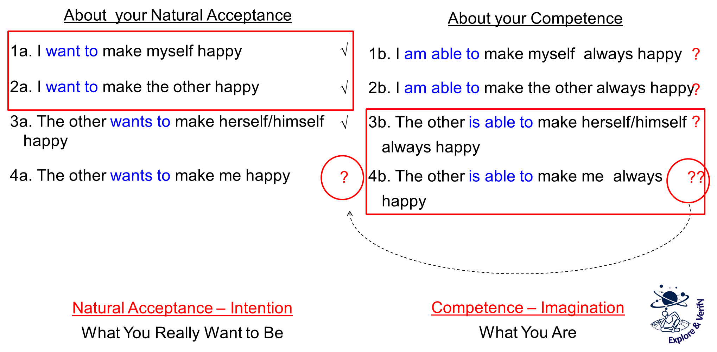
Common Mistake in Relationship
I evaluate myself on the basis of my intention
I evaluate the other on the basis of their competence
I doubt their intention. I assume their lack of competence to be their lack of intention
→ I feel opposed to the other, I get irritated, angry…
I may not speak to the other for days… or even breakup the relationship… One may have lost many good friends like this…
Doubt on intention is a major reason for problems in relationships

Slide 13
Some Common Misunderstandings about Trust
Confusing intention and competence
Intention = natural acceptance
Competence = % of imagination guided by natural acceptance
Confusing trust with dependability
Trust is based on understanding – is definite, does not change with time or person
Dependability is based on events – can keep changing
Confusing intention and desire
Intention = natural acceptance
desire is a part of imagination, is not necessarily guided by natural acceptance
not necessarily same as intention
and maybe others…
Notes:
Time permitting, one may discuss these
Detailed at the end of the main presentation

Slide 14
Self Reflection
If you have unconditional, continuous trust on intention (natural acceptance) of the other and if the other is lacking competence, what will you do:
Try to improve his competence (and also improve your competence)
Get irritated
Get angry
Have a feeling of opposition
How many persons, in your family and friends, do you have trust on intention (natural acceptance) – unconditional, continuous?
This is fundamental. Trust on intention is the foundation of relationship
You can get an idea of the state of your understanding about relationship from this exploration…
Trust on Intention → Response
Doubt on Intention → Reaction
Notes:
Questions and discussions Response is an indicator of harmony within
Reaction is an indicator of disharmony within
Whenever the other is not able to behave as per your expectations then normally what happens – Response or reaction?
If reaction, then how do you feel within? Comfortable or uncomfortable? Do you also feel the need to improve yourself? to explore something further?

Slide 15
Trust: To have the clarity that the other intends to make me happy
About your Natural Acceptance
1a. I want to make myself happy always
2a. I want to make the other happy always
3a. The other wants to make herself/himself happy always
4a. The other wants to make me happy always
About your Competence
1b. I am able to make myself always happy
2b. I am able to make the other always happy
3b. The other is able to make herself/himself always happy
4b. The other is able to make me always happy
√
?
√
?
√
?
√
??
Natural Acceptance – Intention
What You Really Want to Be
Competence – Imagination
What You Are

Slide 16
About the Other
About Myself
The glass broke by accident
The other got late again
Even if the other makes the same mistake 100 times…
– I am clear about his intention
– I know the mistake is due to lack of competence, not a lack of intention
– I make effort to help improve his competence with a feeling of affection
I know that “he may have difficulty understanding… and also, I may have difficulty in explaining…”
The glass broke by accident
I got late again
When I make a mistake even once…
– I am clear about my intention
– I know the mistake is due to lack of competence, not a lack of intention
– I make effort to improve my own competence (I am willing to learn)
Trust on intention is the starting point for mutual development

Slide 17
Resolution of Concerns in Relationship
By understanding trust… I have the feeling of trust in me
Anger, irritation, opposition in me reduces…
I can see that the intention of the other is the same as my intention
I can see that the competence may be lacking in me also, not just in the other
I begin to see the strengths of the other, not just the weaknesses
I can see that it takes time for me to develop my competence, and it is the same for the other – thereby I redefine my expectations, become complementary
I am able to relate in a more natural manner with the other. I discuss more freely, share more openly…
and I start working for mutual development

Slide 18
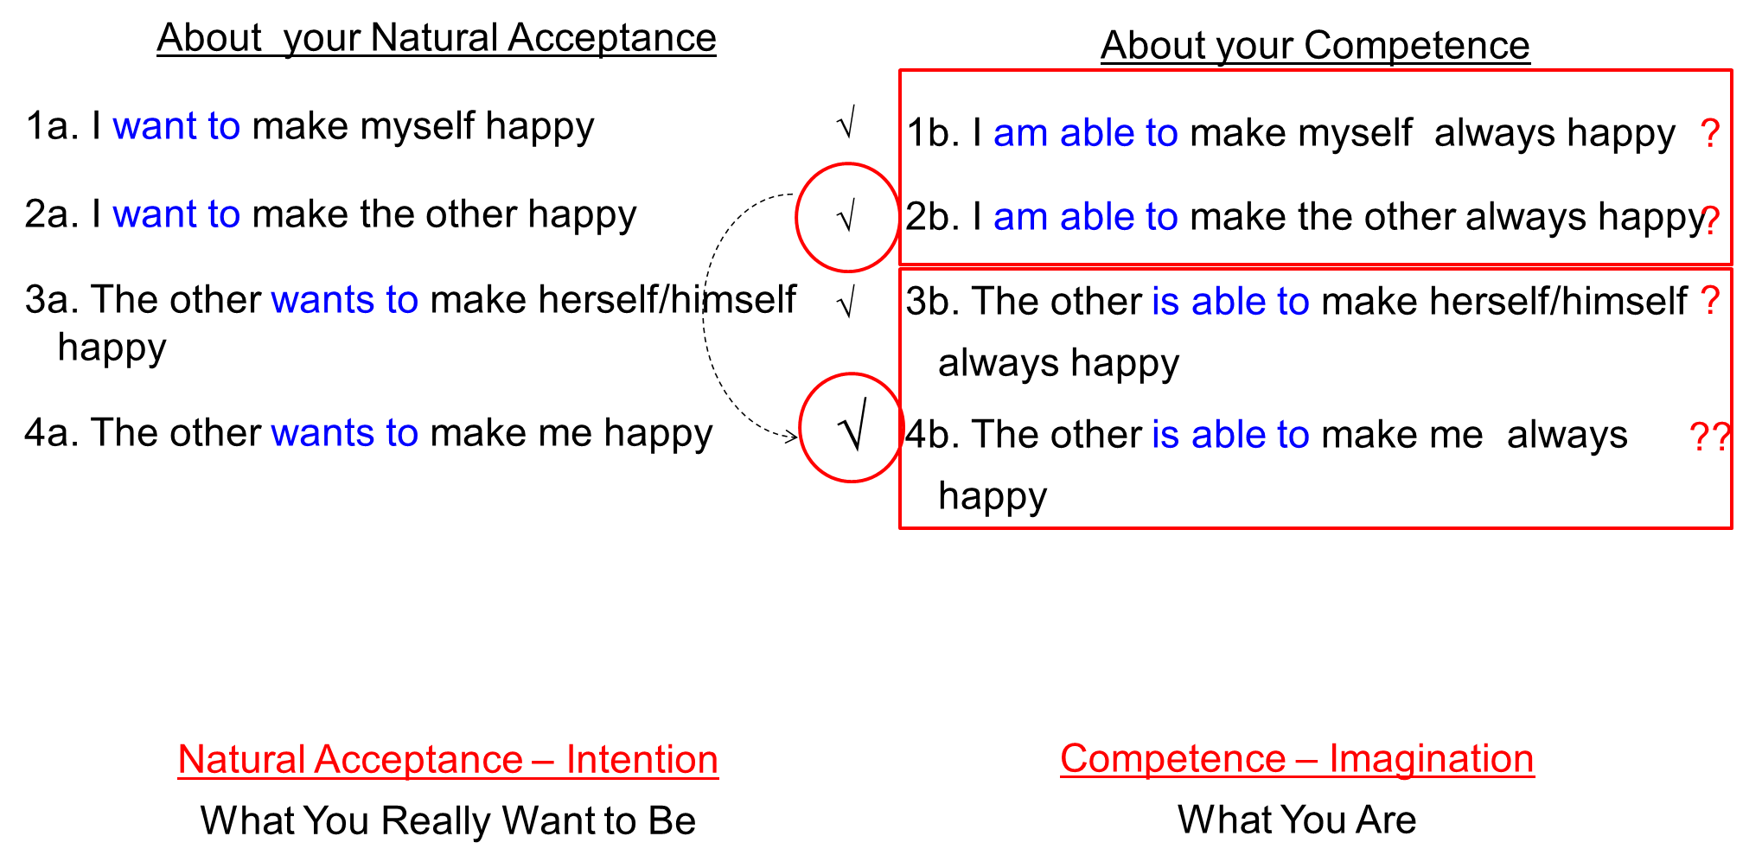
Sum Up: Trust, the Foundation of Relationship
Trust is to be assured that the other intends to make me happy and prosperous
It is the foundation of relationship
I can see that the competence may be lacking in me also, not just in the other
Anger, irritation, opposition in me reduces…
I start working on developing my competence first and become a help in the development of the competence of the other
Trust on intention is the starting point for mutual development

Slide 19
Home Assignment

Slide 20
Home Assignments
8.1. How many persons, in your family and friends, do you have trust on intention (natural acceptance) – unconditional, continuous?
You always make effort to improve mutual competence
(your own competence as well as the competence of the other)
rather than getting irritated, angry or having a feeling of opposition
(even for a moment)
8.2. In case you get angry/irritated:
Do you feel happy when you get angry? And when you express your anger?
What is the outcome when you express your anger? Is it mutual happiness?
What is the reason for your anger? Is it the other or you?
8.3. Talk to 2 close friends you may have lost, due to lack of trust. Tell them you have realised the difference between intention and competence… and that you want to reconnect. Write down their response or reaction – you may like to share it in the next session

Slide 21
Questions?

Slide 22
Anger – Reason Anger – Solution
Anger arises, when we are not able to differentiate between the intention and competence of the other. Based on lack of competence of the other, we doubt over their intention
Once, we have a doubt on the intention of the other, then instead of relating to the other, we feel in opposition to the other
Thus, any small unfavourable incidence may lead to irritation or even anger
When I understand the human being correctly, then am able to see-
“The other is a human being like me (self and body)”
The other self has the intention, i.e., natural acceptance just like me
(to be happy and make other happy)
The other may be lacking in competence to fulfil their intention, just like I may be lacking in competence
We are both trying to improve our competence, so we can help each other to develop (be complimentary to each other)

Slide 23
Anger – Reason Anger – Solution
When our desire does not get fulfilled and we perceive that it is due to the other, then we get irritated or angry
If I can see that the other has the right intention, but lacks competence, then instead of getting angry, I re-examine my desire/expectation and action:
Is my expectation right or not?
Is the program to fulfill the desire correct or not?
Have I developed the necessary competence in myself ?
What effort have I made to help the other in improving his/her competence?

